Slide 1
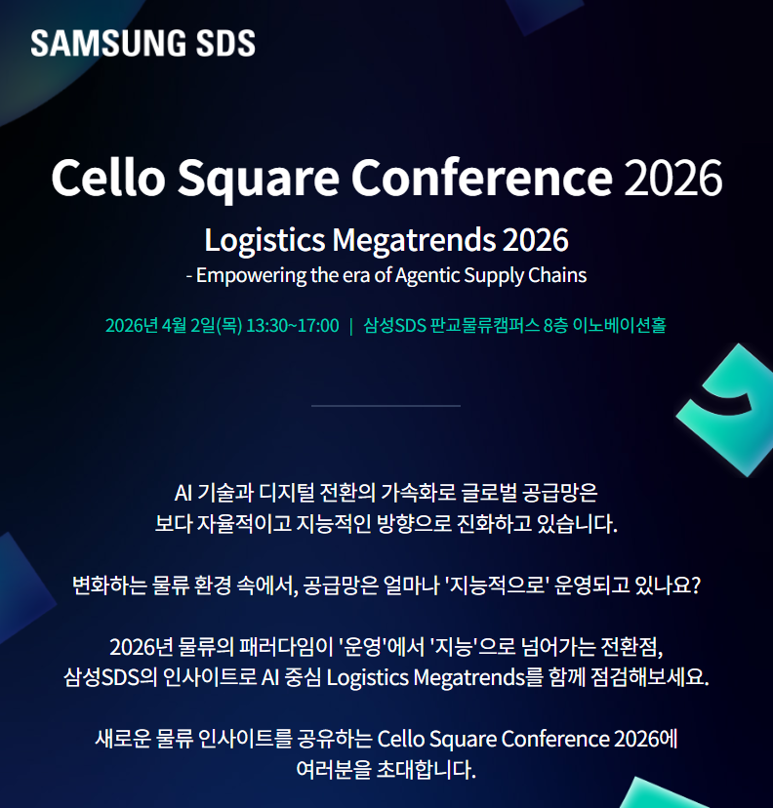
로고 유지
Cello Square Conference Hungary 2026
Navigating the Future of Intelligent Supply Chains
- Adapting to Hungary's Evolving Environmental Regulations and Permitting Landscape
August 28th (Friday) 14:00~18:00 I Crowne Plaza Budapest by IHG 2F Black & White room
Global supply chains are undergoing unprecedented transformation. Driven by AI, digital technologies, and geopolitical uncertainty, businesses must build more resilient, intelligent, and sustainable supply chains.
At the same time, companies operating in Europe, particularly in Hungary, are navigating increasingly stringent environmental regulations and evolving policy landscapes, requiring more agile and proactive supply chain strategies.
The Samsung SDS Cello Square Conference Hungary 2026 brings together industry experts and business leaders to explore the AI-driven logistics megatrends shaping the future of supply chains and to share practical insights into building smarter, more resilient, and sustainable logistics operations.
Join Samsung SDS to discover how intelligent logistics and digital innovation can help your business navigate change and unlock new opportunities for growth.

Slide 2
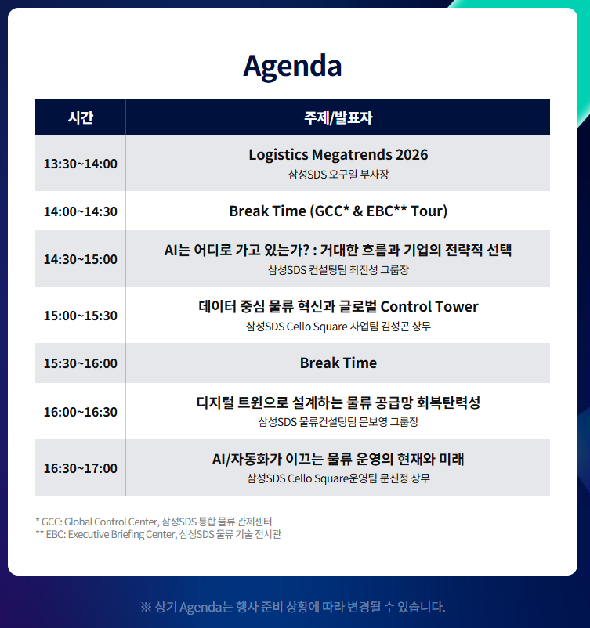
유지해주세요
Time | Program & Speakers
14:00~14:30 | Welcome & Registration Hongseok Lee – Samsung SDS
14:30~14:40 | Open Speech Wonwoo Cho, Head of Logistics Division (SVP) – Samsung SDS Europe
14:40~15:20 | Environmental Regulations and Trends in the EU and Hungary Jihye Lee, Lawer – JIPYONG
15:20~16:00 | Hungary's New Government Tightens Permission Requirements - A shared risk for Korean and Chinese battery companies Kyungchul Park, CEO – AFGM
16:00~16:30 | European Ocean Freight Market Outlook Deoklim Choi, Head of Pricing Team(VP) – Samsung SDS Europe
16:30~17:00 | Introduction to the SAMSUNG SDS Logistics service Hyunjae Shin, East EU biz team leader– Samsung SDS
17:00~17:10 | Lucky Draw (Samsung TV and others) Hongseok Lee – Samsung SDS
17:10~18:00 | Networking(Beverage & Canapes)
삭제해주세요
※ The agenda is subject to change without prior notice.

Slide 3
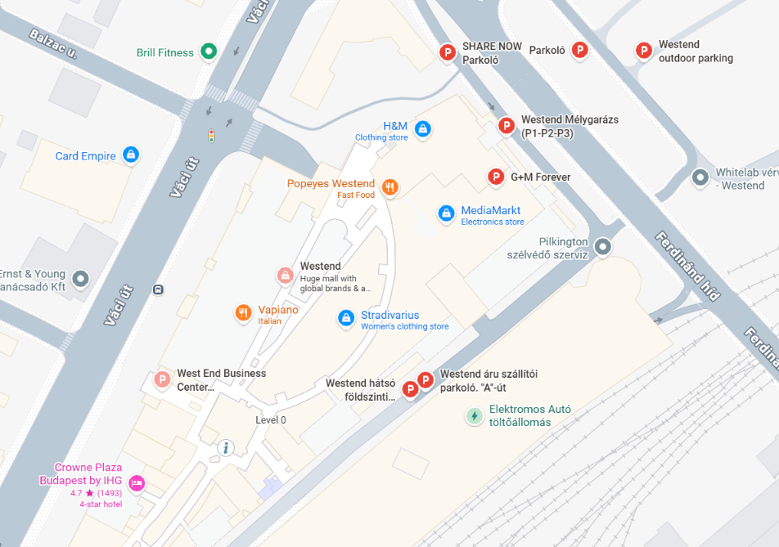
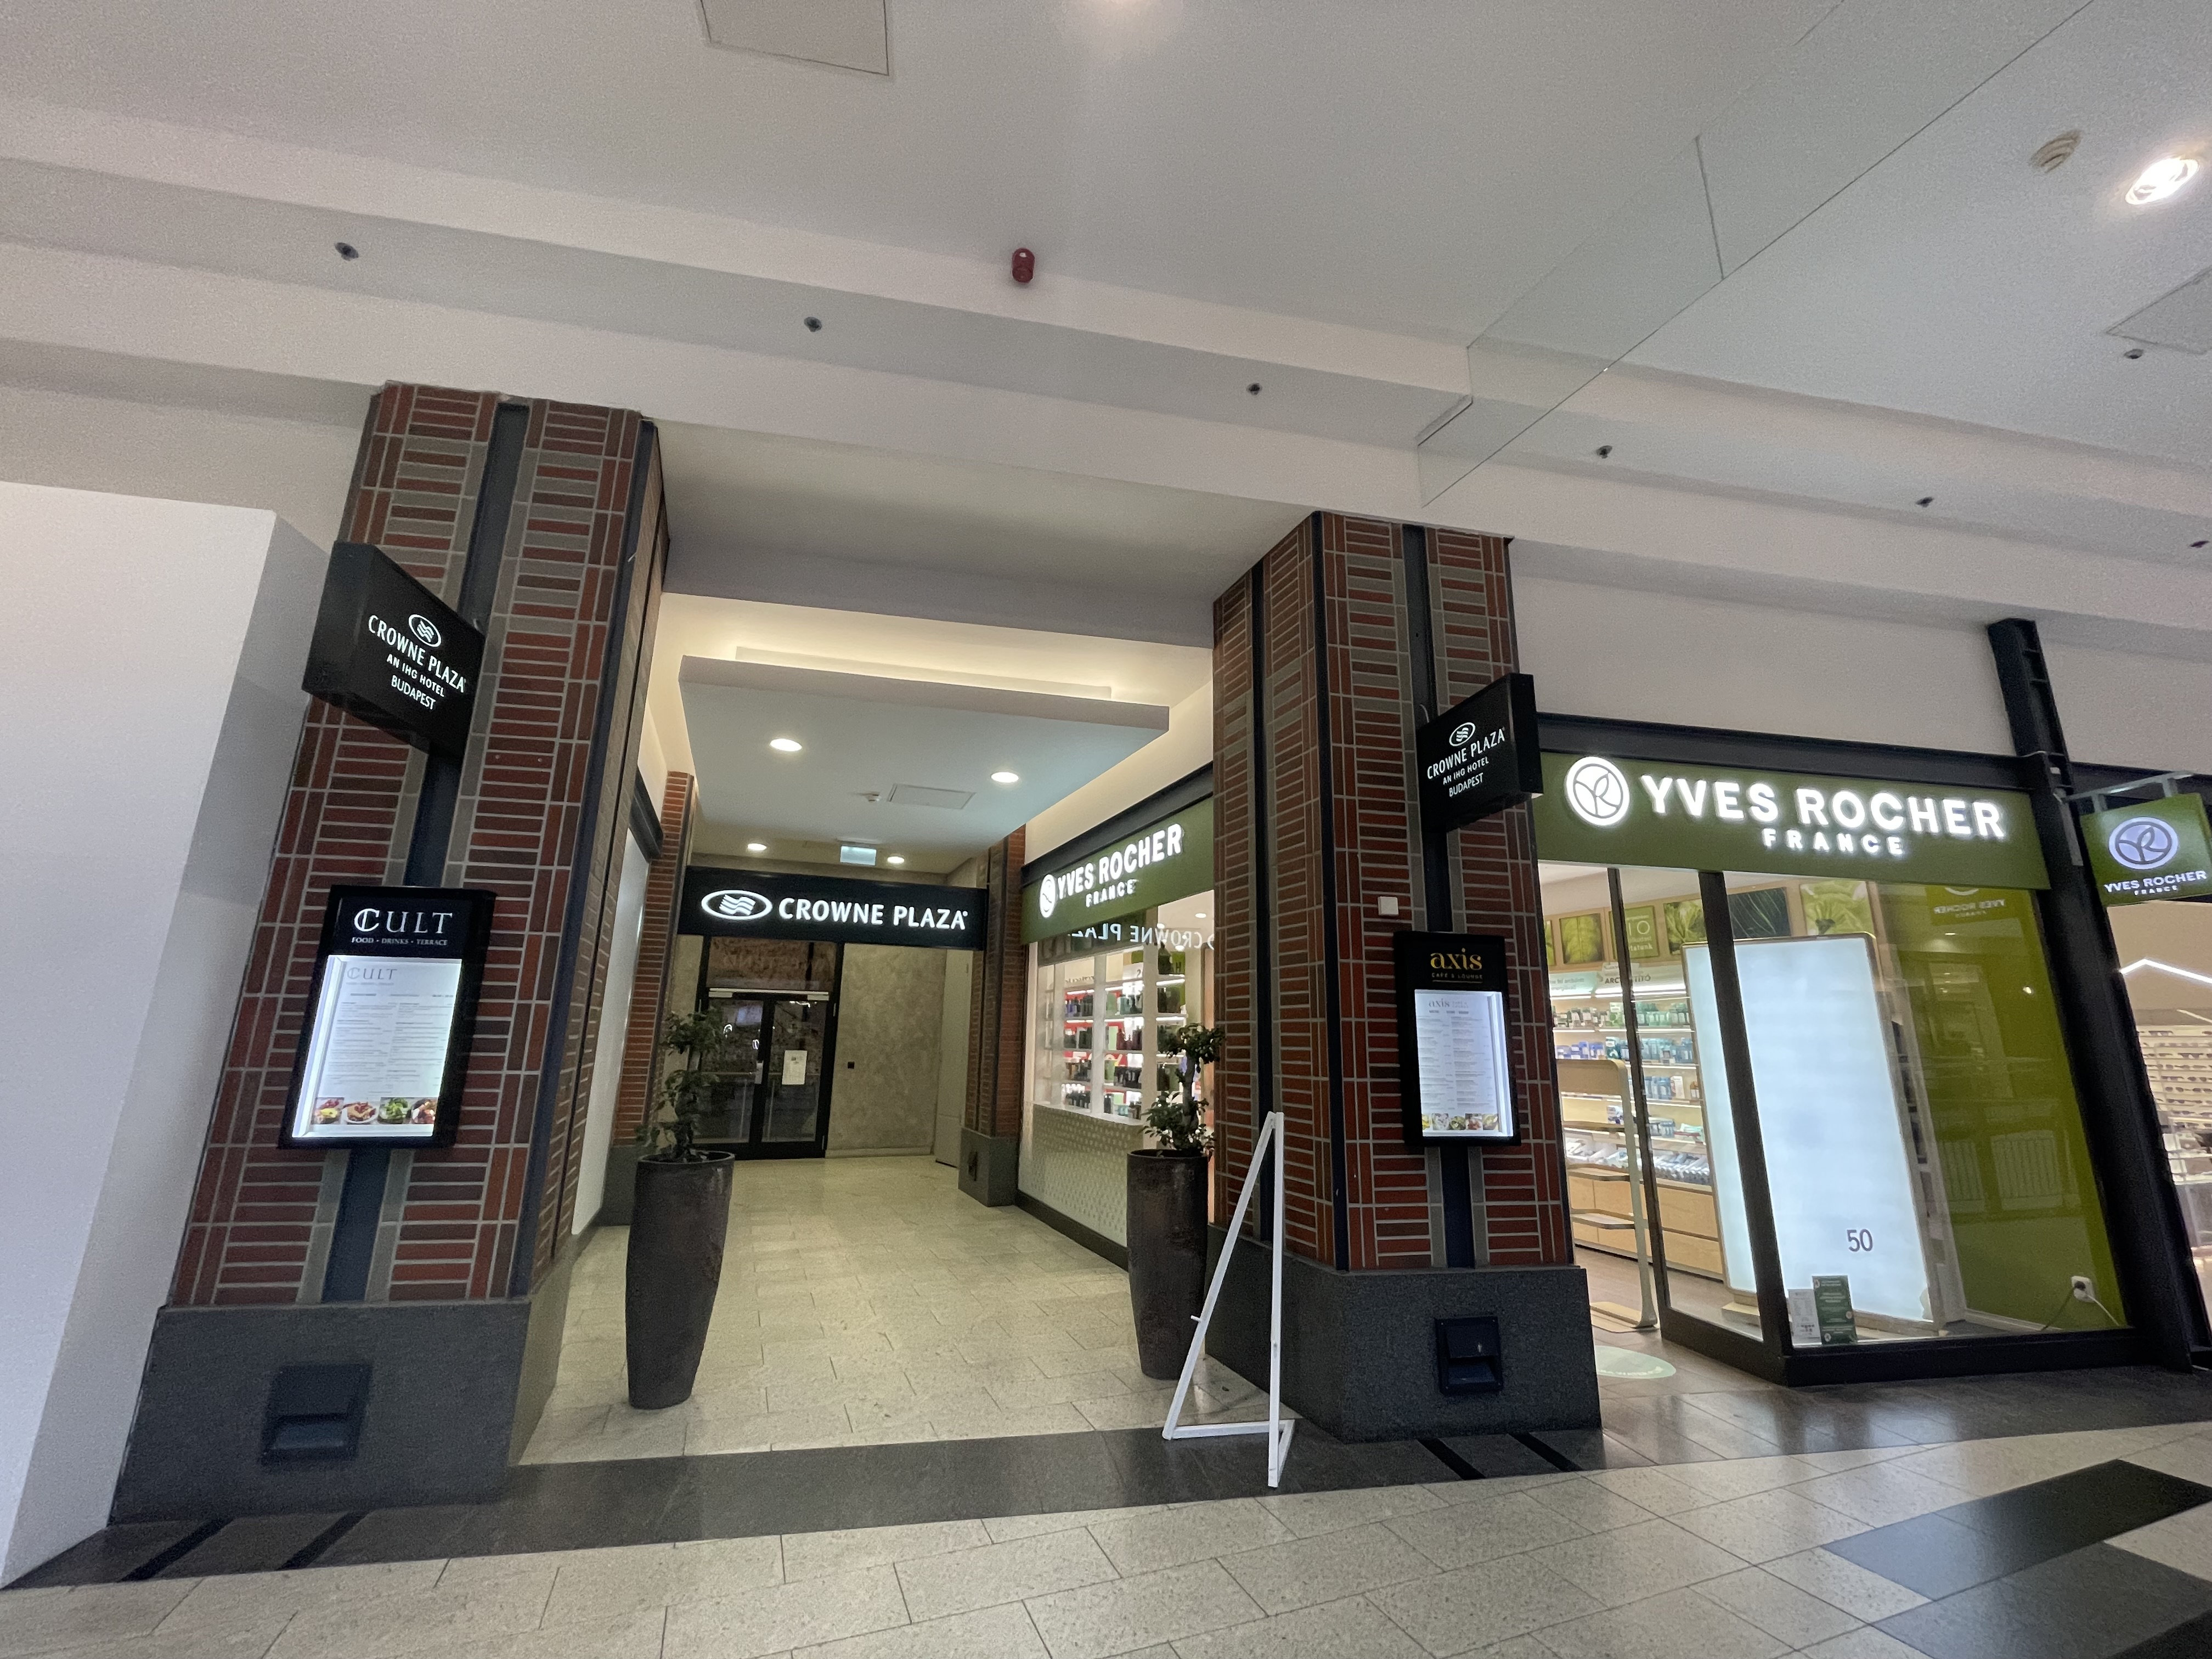
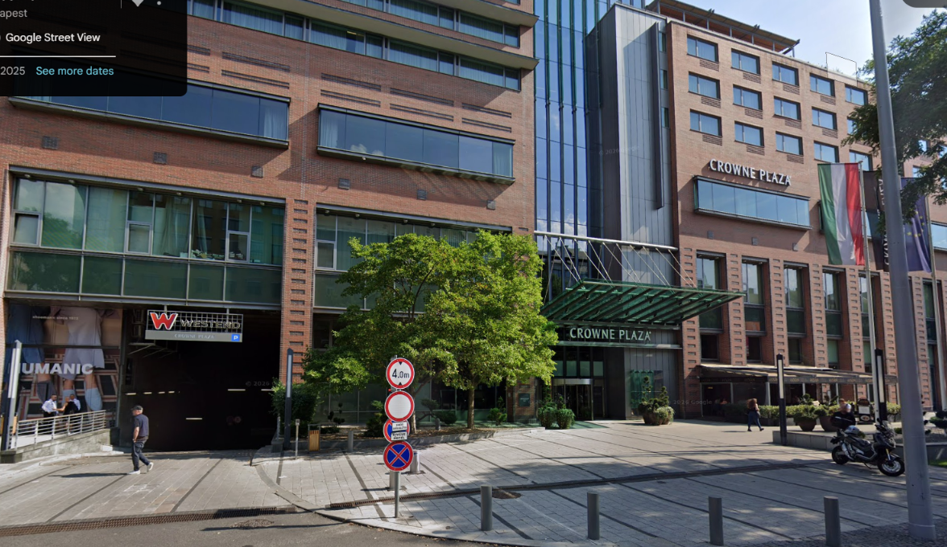
Crowne Plaza Parking lot Entrance
* Please come up to 1F through the Westend parking lot.
Crowne Plaza Parking lot Entrance
Crowne Plaza Budapest by IHG
2F Black & White room
Budapest Váci út 1 1062
(Please note that hotel parking is limited. Additional parking is available at the Westend Parking Lot)

Slide 4
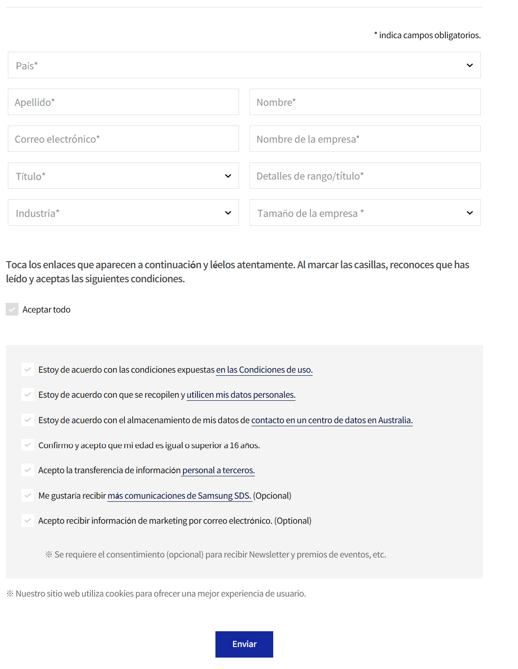
좌측의 개인정보 입력란 유지해주세요.
해당 사이트 페이지에서 모객 활동을 진행하므로
참가자들께서 해당 양식에 맞춰 개인 정보를 입력할 예정입니다.

